Slide 1
Assignment

Slide 2
Assignment 1
Write a C# program to input marks of five subjects Physics, Chemistry, Biology, Mathematics and Computer. Calculate the average and grade according to following:
Percentage >= 90% : Grade A
Percentage >= 80% : Grade B
Percentage >= 70% : Grade C
Percentage >= 60% : Grade D
Percentage >= 40% : Grade E
Percentage < 40% : Grade F

Slide 3
Assignment 2
Write a C# program to check whether a triangle is equilateral, isosceles or scalene triangle. (Hint, use nested if)

Slide 4
Assignment 3
Prompt the user for a number and print good if the number is between 22 & 32 or greater than 103. Otherwise, print bad.

Slide 5
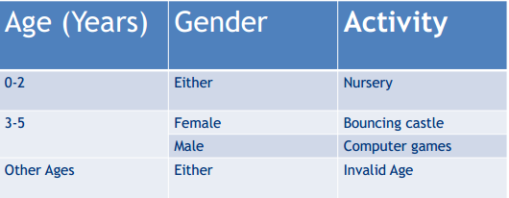
Assignment 4
Using the table below, write a program that will assist in determining the activity that a child will play based on his/her age and gender.

